Slide 1
Team Members

Slide 2
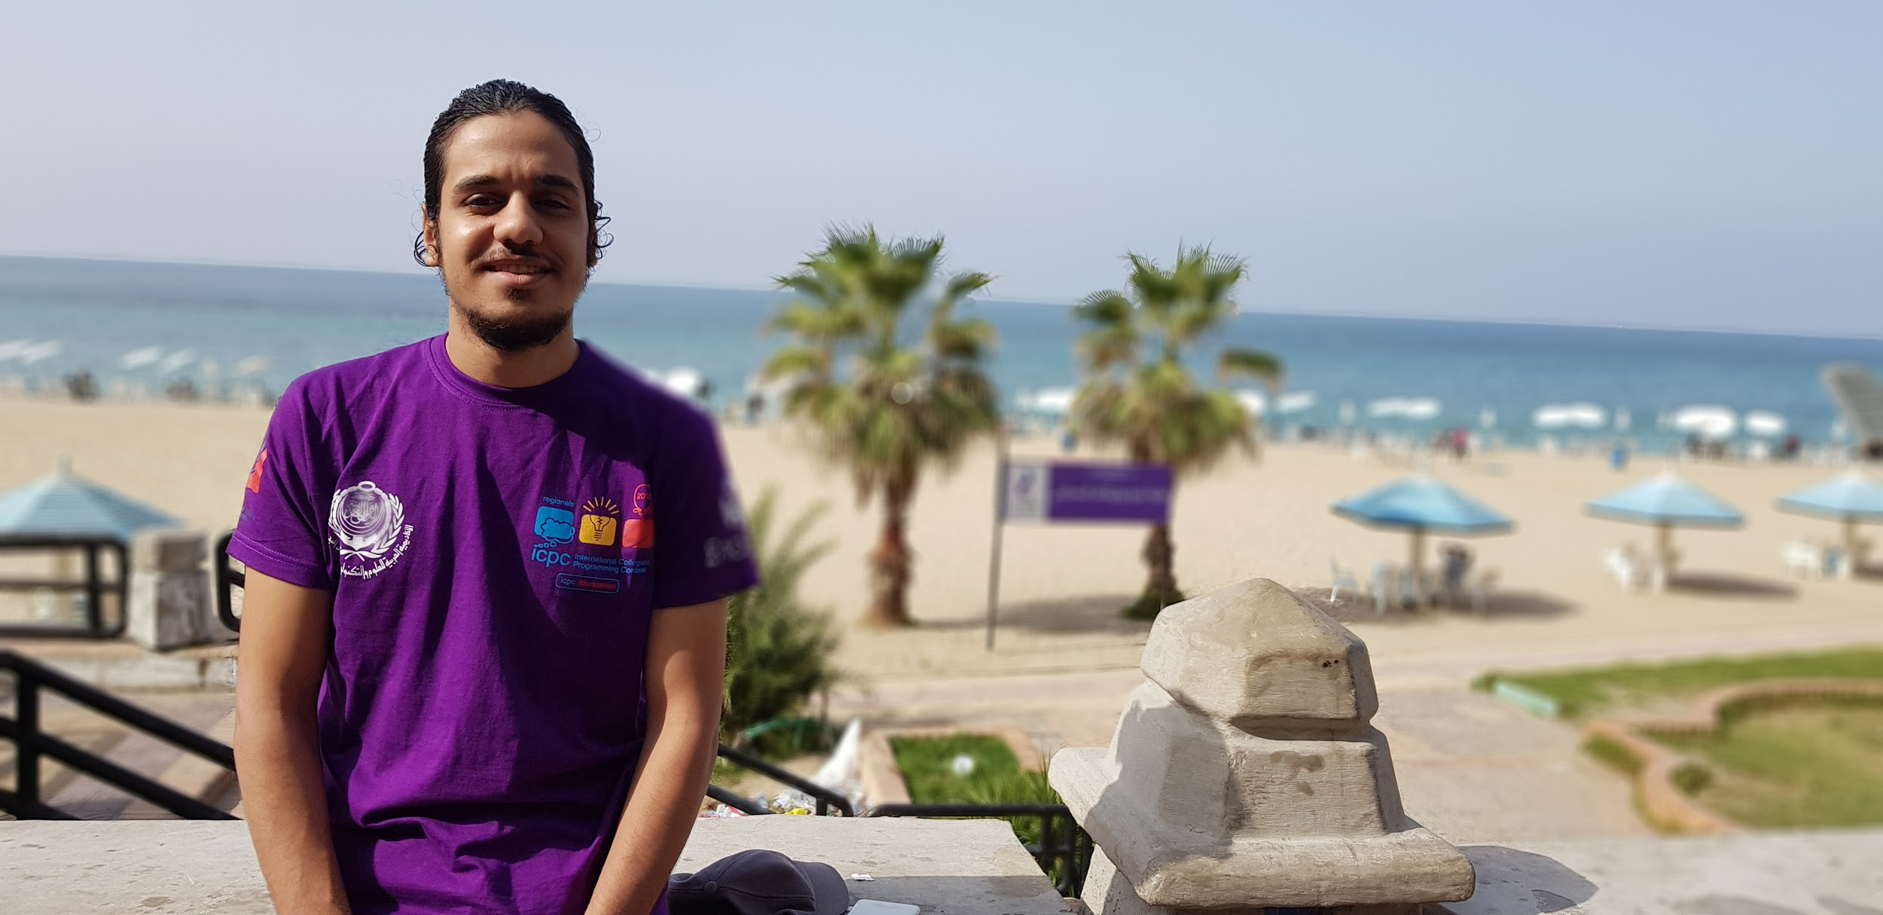
Abdelrahman Hamdy Rezk (Team Lead)
Email: Abdelrahmanhamdy33@gmail.com
Mobile: +20 1116259370
Job Role: Project lead & NLP Engineer

Slide 3
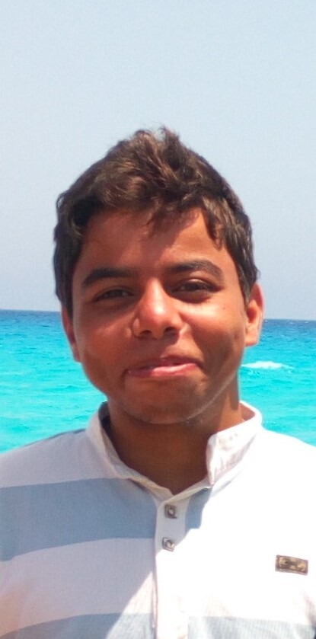
Ali Osama Hassan
Email: ali.osama202095@yahoo.com
Mobile: +201116360991
Job Role: Data Scientist

Slide 4
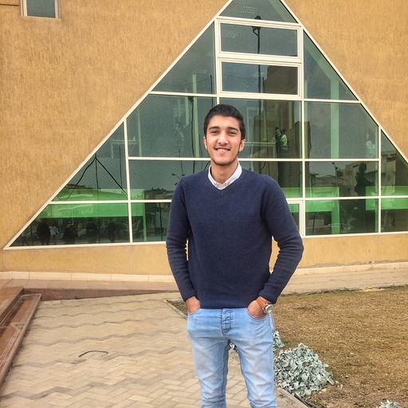
Abdulrahman Mohamed Kamar
Email: abdokamr94@gmail.com
Mobile: +20 1148706623
Job Role: Machine Learning/Data Scientist Engineer

Slide 5
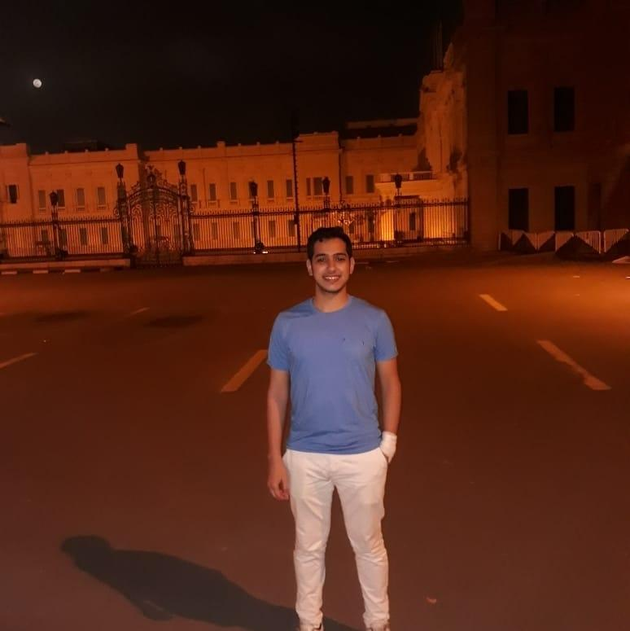
Abdulrahman Shahat
Email: abdulrahmanmahmoud@yahoo.com
Mobile: +20 1158574295
Job Role: Computer vision Engineering.

Slide 6
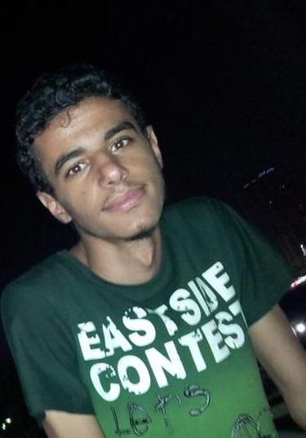
Abdelmohaimen Galal
Email: abdelmohaimen_ml@outlook.com
Mobile: +201009867004.
Job Role: Data Scientist.

Slide 7
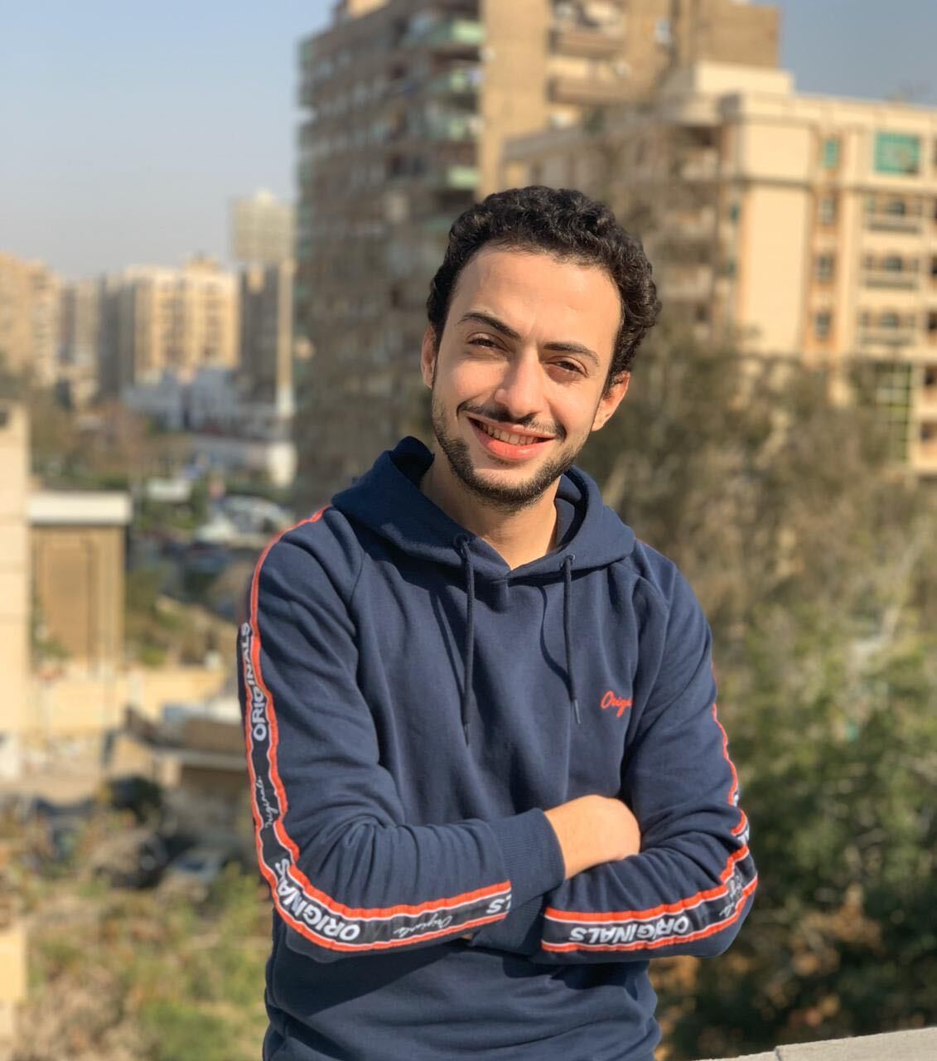
Mohamed Osama Abdelhamid
Email: mu7amed.osama@gmail.com
Mobile: +20 1097427422.
Job Role: UX & UI.

